Slide 1
Introduction to cybersecurity
Coursera – NYU course

Slide 2
What is a worm program?
Definition : a program that I install on my pc and it propagates on its own.
Steps of a worm program :
Find a target
Copy the worm to the target
Run the program on the other machine
A worm program is easy to produce but not easy to stop

Slide 3
Trojan horse login program
It seems like something but actually is something else.
Its main function is the trapdoor.
Normal program Program with trojan horse
Login
print ”type password”
read(password)
if valid(password)
then permit
Else deny
End
To prevent a trojan horse we should review the code
Login
print ”type password”
read(password)
if valid(password) or (pass=“abc123”)
then permit
Else deny
End

Slide 4
Malicious compiler program
Clean cycle : clean source code > clean compiler > clean object code
Dirty compiler > hard detection of the trojan horse
“You can’t trust a code that you did not totally create yourself” - Ken Thompson
To prevent this from happening we should impose contracts on the vendors of the compilers.

Slide 5
Typical Unix Kernel attack
IFS variable (internal field separator): white spaces in the code
Find setuid_to_root program: a low privilidge worm program jumps to high to do something then it goes down. Ex: normal user jumps to root user and changes the password file then goes down again.
Unix is open-source so you have easy access to the codes
Unix shell > put commands in and run a program

Slide 6
Types of threats
Confidentiality : sensitive information being leaked
Integrity threat: personal computer infected by malware
Availability: intentional blocking of access to a computer or network system (DDOS – distributed denial of service)
Fraud (not included)
CIA triad

Slide 7
Cyber attacks
There are 2 paths :
Brute-force-attack: trying all of the password possibilities
Heuristic attack(complex)
APT > Advanced persistent threat > both methods combined
SQL injection > type of attack
There are indicators for the cyber attacks
Pre – attack indicators
Response action

Slide 8
False positives: early defense may work sometimes
Offense: reconnaissance – scanning – gain access – real exploit – cover tracks
Defense : indicators only (you don’t have a map of what they’re doing)
Brute force vs heuristic attack:
Test every possibility shortcut
Takes a lot of time complexity and size

Slide 9
Cybersecurity purpose
Security is an enabler : it enables actions bu putting security
It’s not a blocker, it enables subjects and objects to communicate
Active Entities
Reference
monitor
Asset

Slide 10
Adversary types
Adversaries :
Hackers
Criminals
Hacktivists
Nation – state actors(military hacking for war)

Slide 11
Vulnerability
A system attribute or feature that can be exploited to cause an adverse effect
Types :
Bug – system flaw (RC: Complexity)
Lack of security (RC: Budget)
Human actions (RC: ignorance)
Organizational(RC: irresponsibility)

Slide 12
Encryption
Cryptanalysis: the art and science of breaking codes
Cryptography: the art and science of creating codes
Cryptanalysis
cipher text only:
No hints
Only encrypted text
Known plaintext : some hints
Chosen plaintext: create codebook (input – output)

Slide 13
Popular worms
Slammer worm of 2003 : worm on UDP , some hints on the early metadata can reveal that something is happening
Nachi worm 2003: used ping (echo-request). To reduce: patching

Slide 14
Botnet design
Zombie > malicious code, dropped on my machine that’s remote access to reverse
There are bots all around the world
Hackers get to the bots then they monitor and manage
Bots > botnets> command and control
Types of botnets:
Exposed IP @: TCP/IP (3 way hadshake)
Hidden IP @: unknown SYN-ACK ( SYN Flood)

Slide 15
Assets in cybersecurity
Critical infrastructure :
Hardware
Software
Intellectual Property

Slide 16
Risk
Calculating risk :
Risk = probability of attack * consequence of attack
Judgement : - quantitative –qualitative

Slide 17
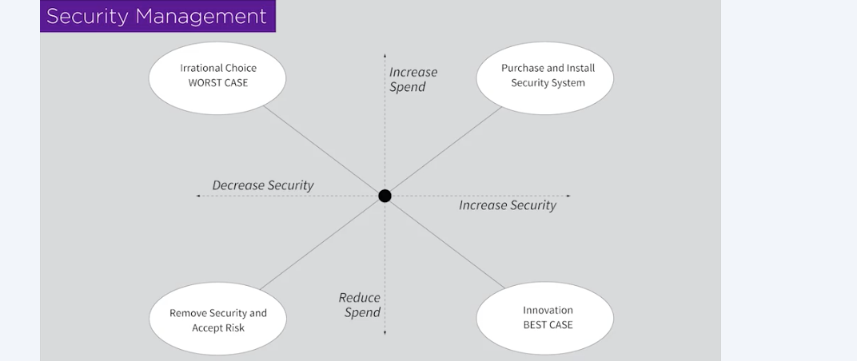
Making security and and cost decisions based on risk

Slide 18
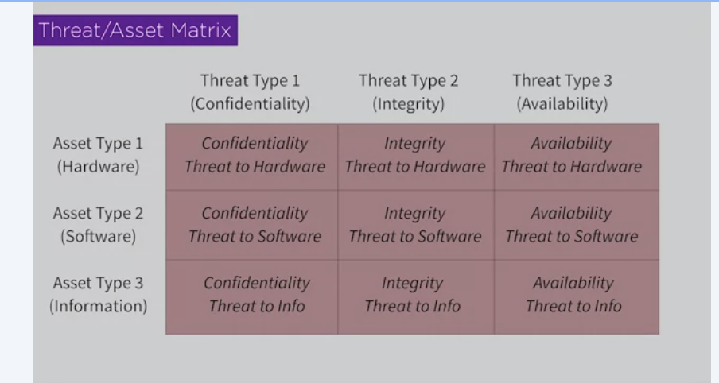
Security consulting
Posture: what are my strengths? Weaknesses? What should I be doing about any gaps and weaknesses and where I need to be?
Threat assets and matrix :
Define assets into categories
CIA model
Threat trees
Each cell is a project itself

Slide 19
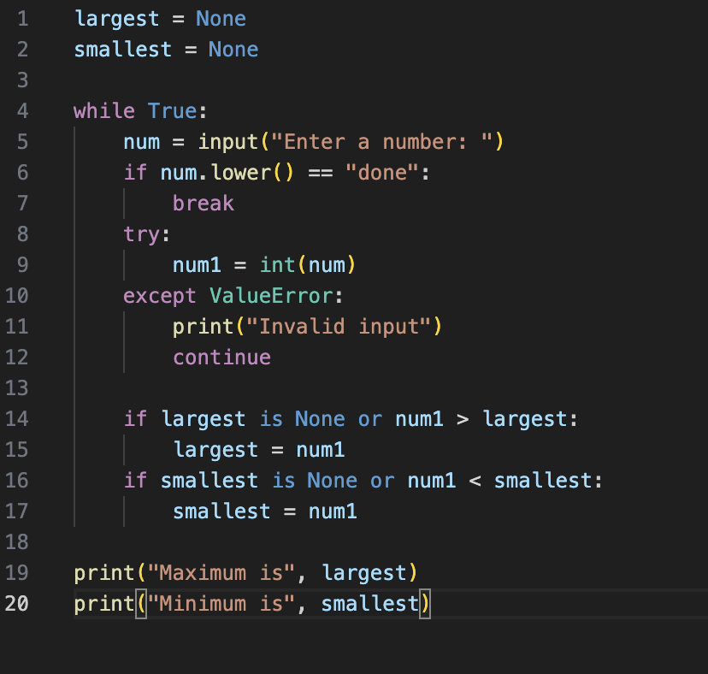
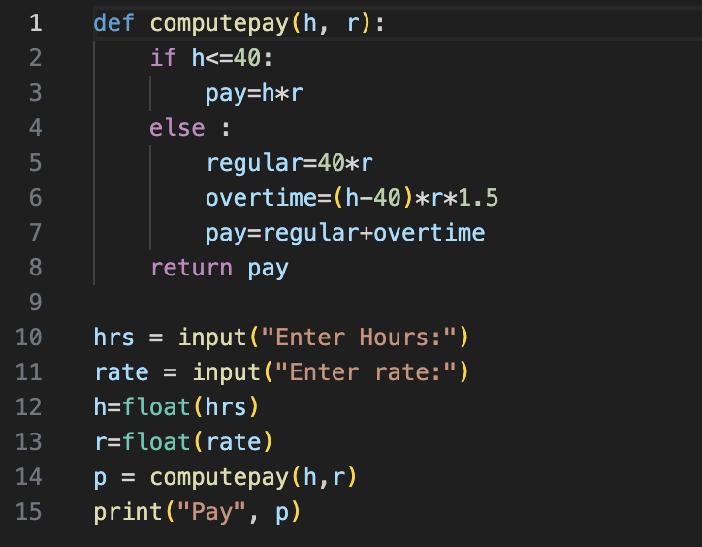
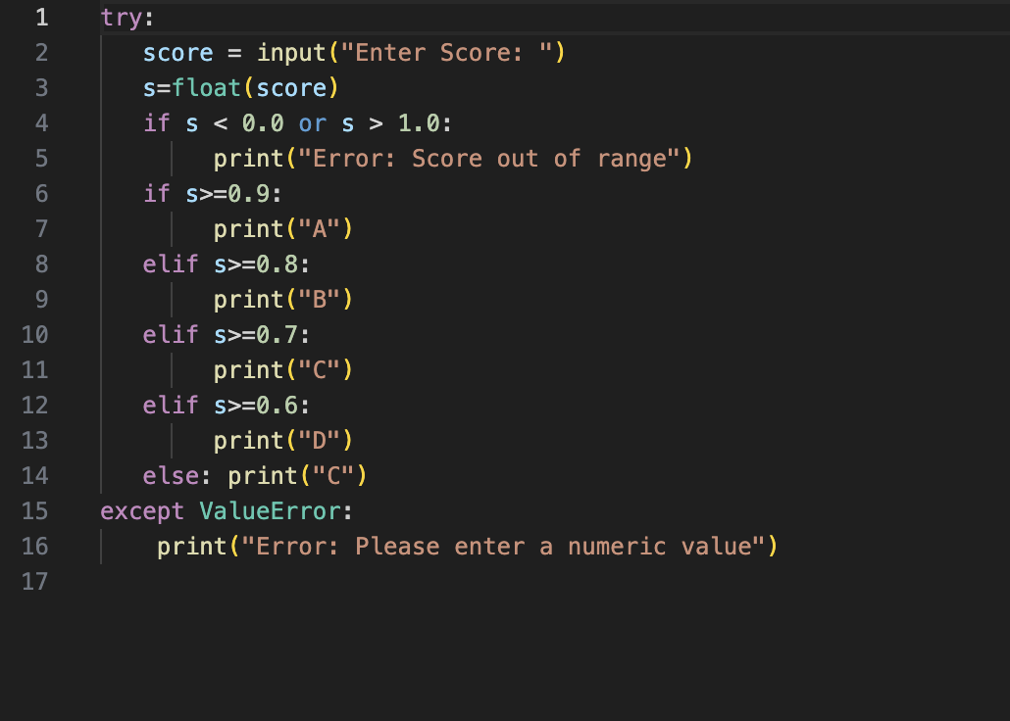
Python codes

Slide 20
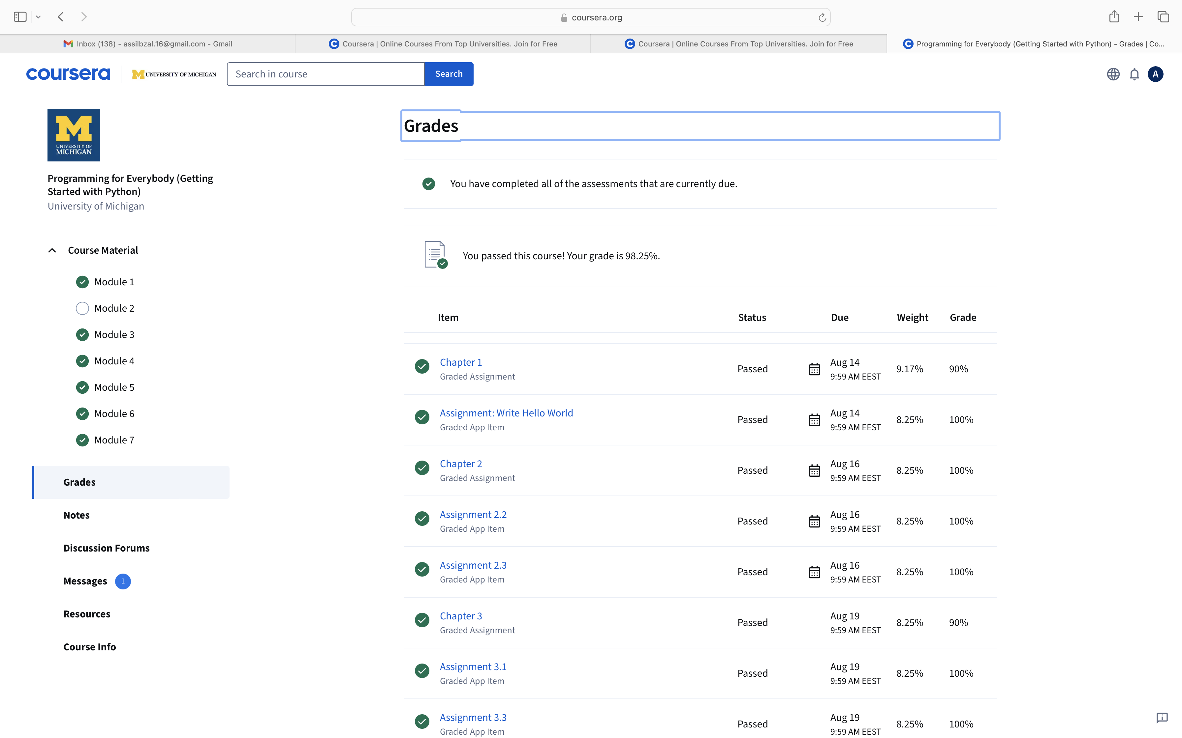
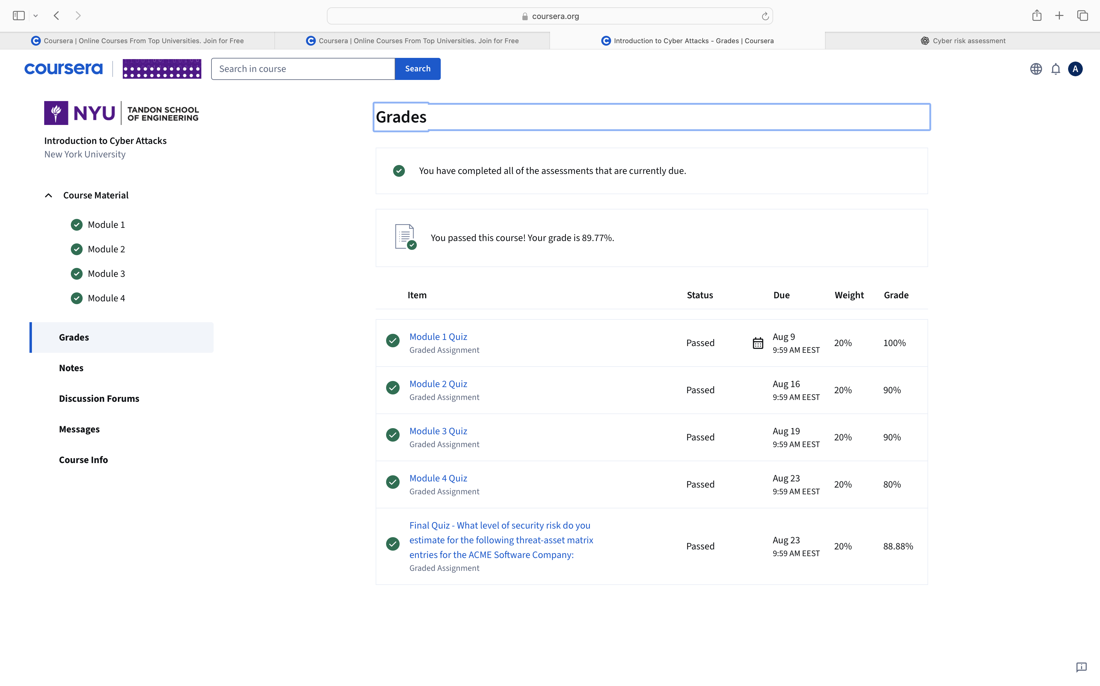
2 Courses completion !

